Slide 1


GOOD DOCUMENTATION PRACTICE EXAMPLE
By :- MAYURI & ARTI

Slide 2
Content
Poor documentation examples
Good documentation examples as per ALCOA
Reference

Slide 3
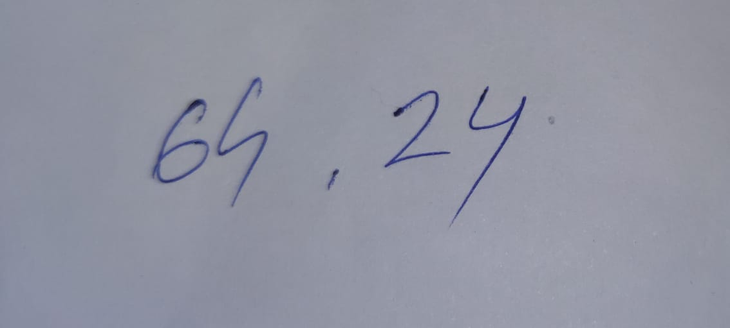
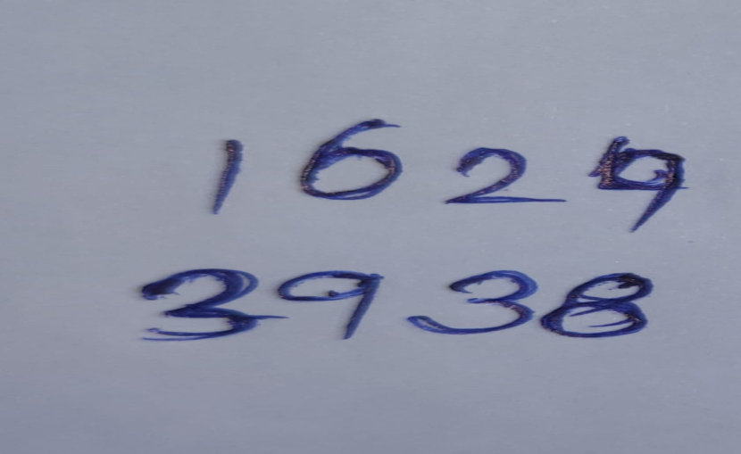

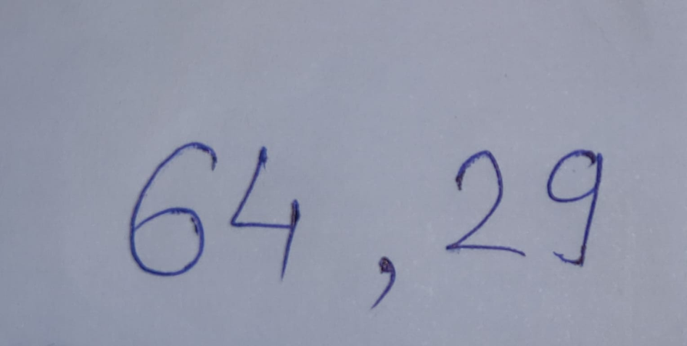
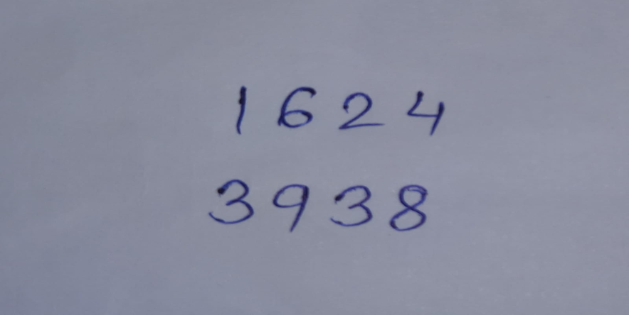

Poor documentation examples (1/5)

Slide 4


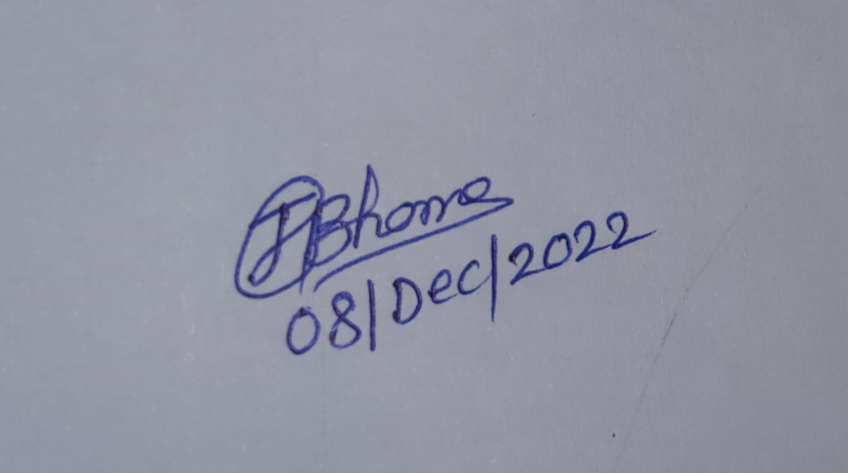

Poor documentation examples (2/5)
A document with original signature should never be destroyed
Never use pencil

Slide 5
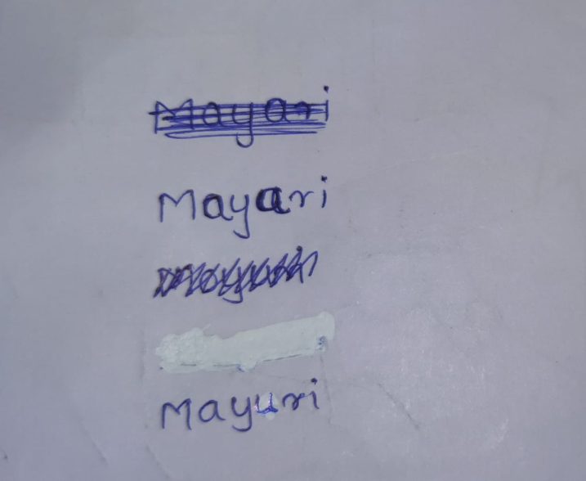
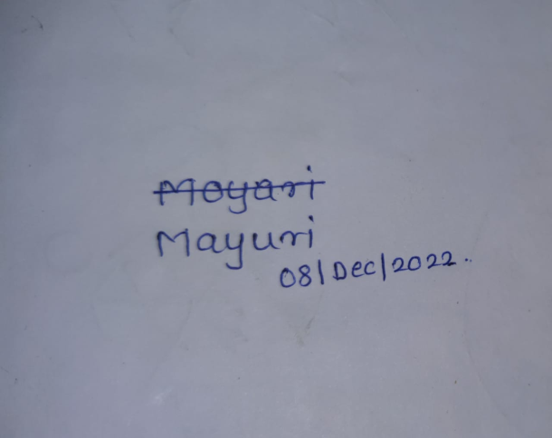

Poor documentation examples (3/5)
Never over right a record
No whiteouts or cover over taps
Write overs, multiple line through

Slide 6
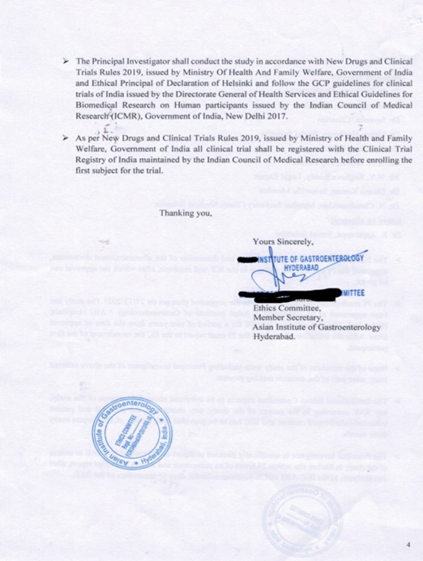
Poor documentation examples (5/5)
Missing Date

Slide 7
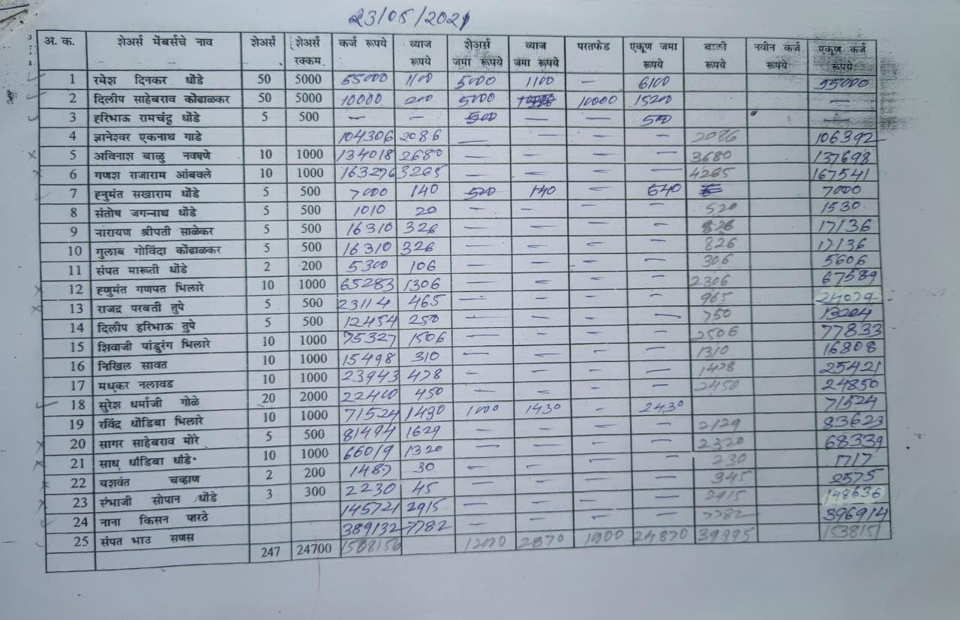
Poor documentation examples (4/5)
Notes:
No space, live or field should are to be blank, no symbols

Slide 8
Attributable (1/2)
Attributable -
Does the documentation clearly demonstrate
Link to its resource(who’s its about)
Who observes and record the information
When data was observed and record

Slide 9
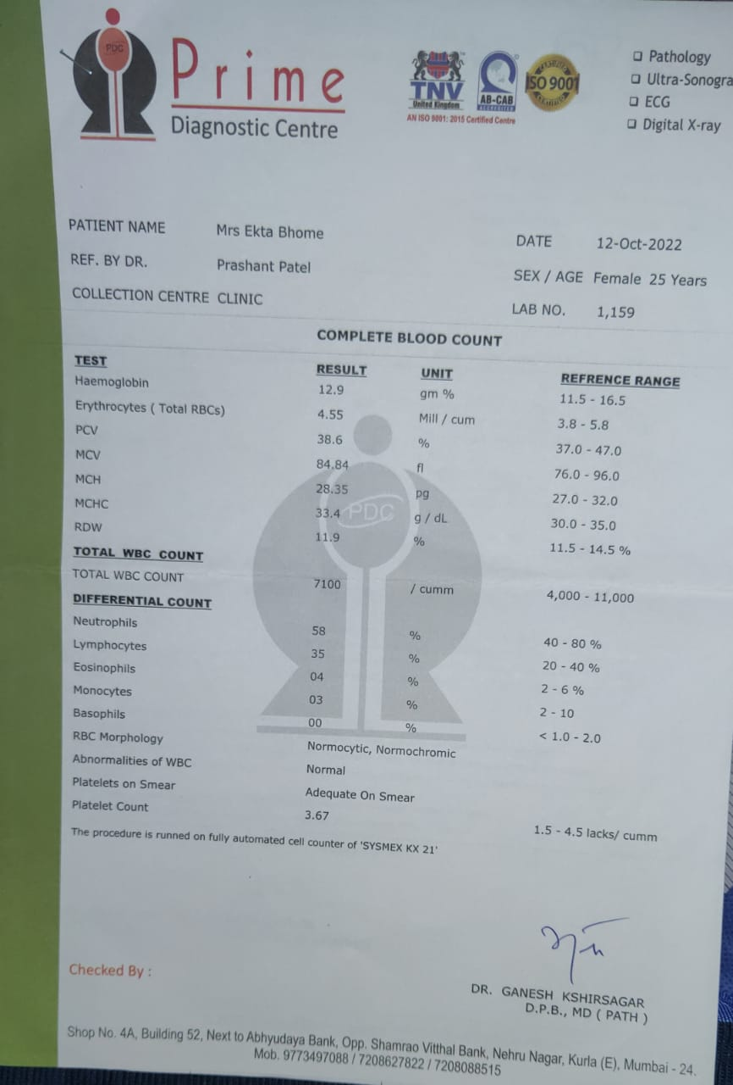
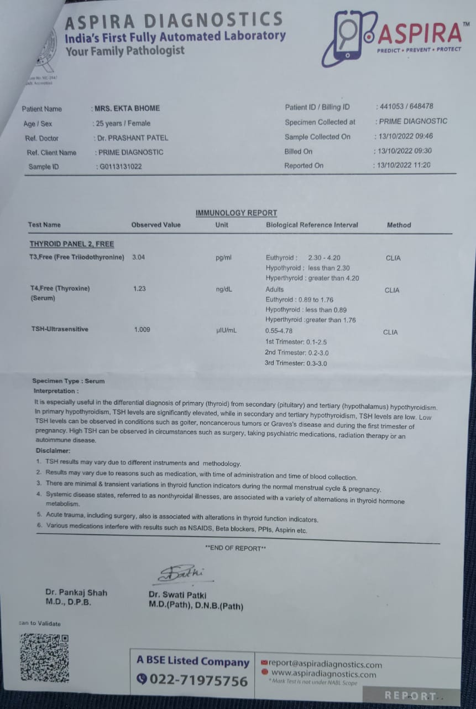
Attributable (2/2)

Slide 10
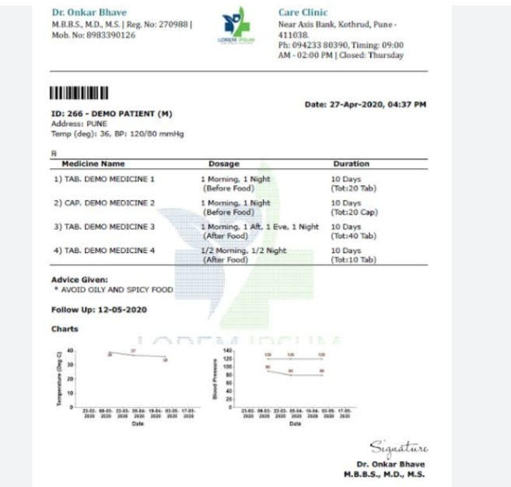
Legible (1/3)
Legible(readable)
Can information can easily understood?
Is it recorded permanently or durable medium?
Have original entries preserved?

Slide 11
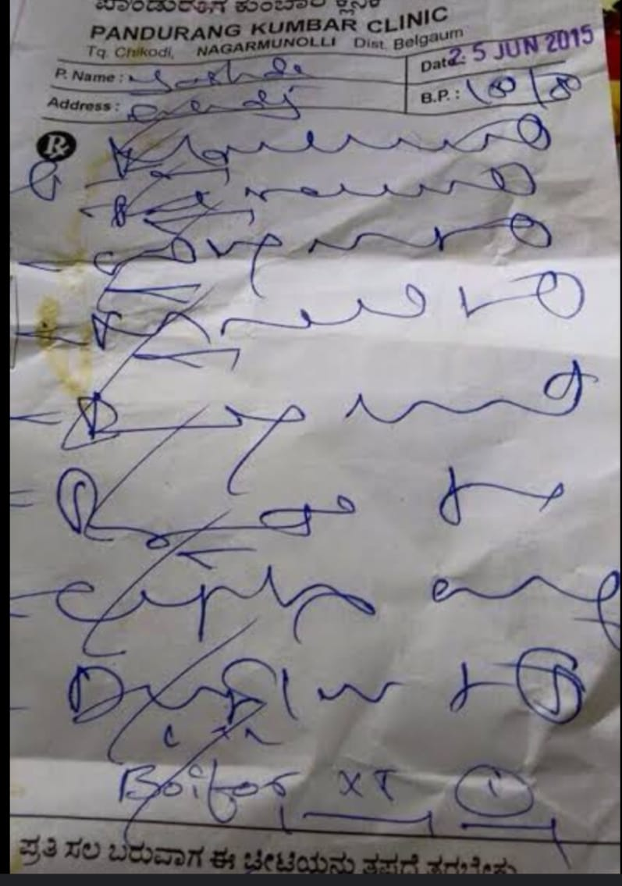
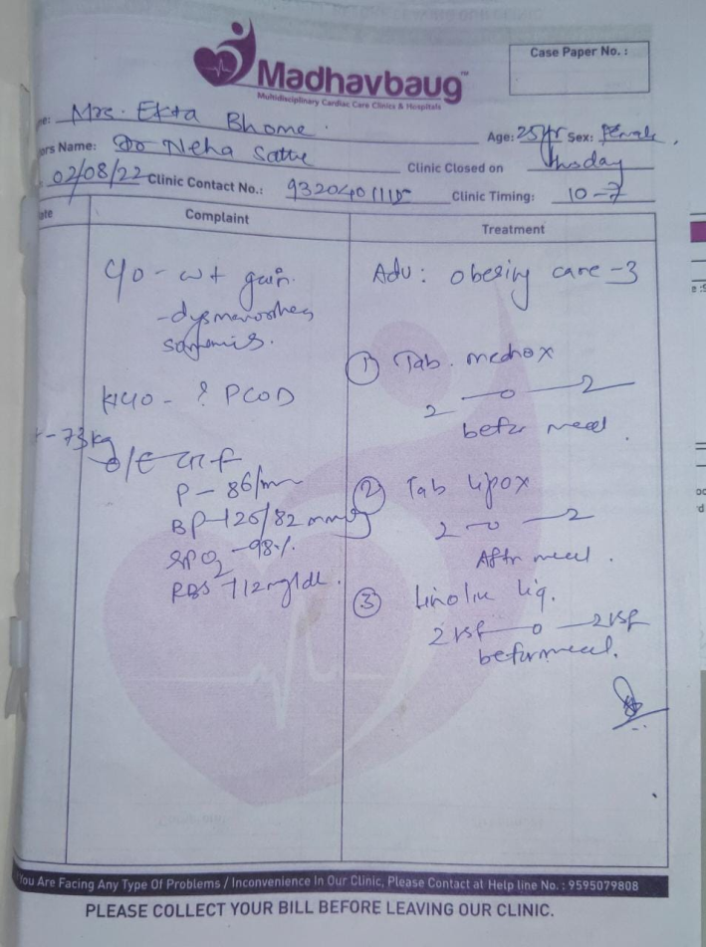
Legible (2/3)

Slide 12
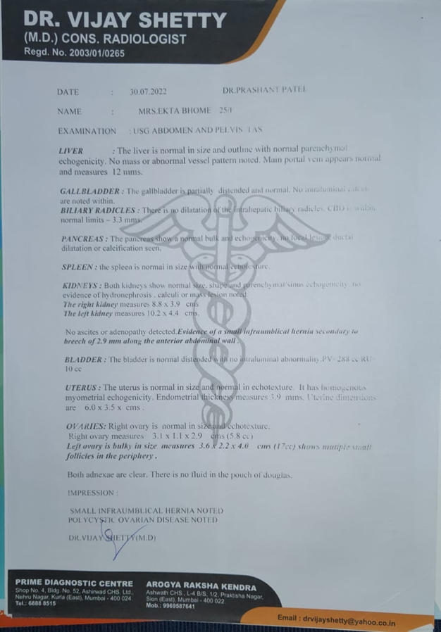
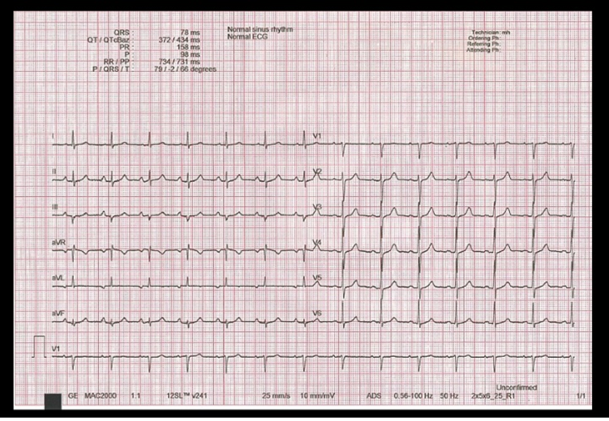
Legible (3/3)

Slide 13
Contemporaneous (1/2)
Contemporaneous -
was the information recorded with timelines?
Complete-does the documentation include all the necessary information?

Slide 14
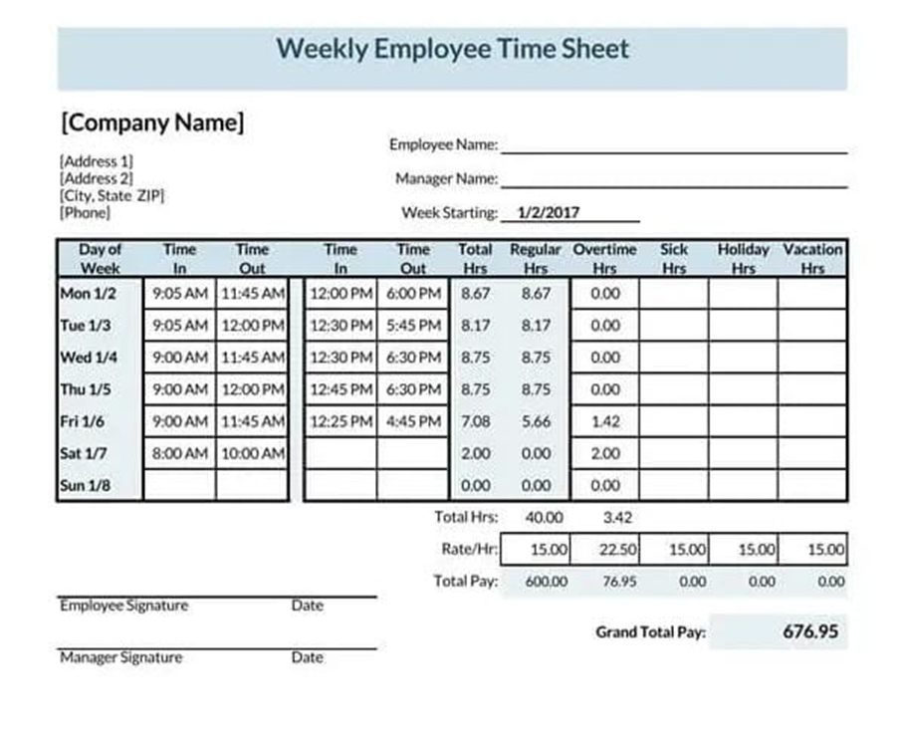
Contemporaneous (2/2)

Slide 15
Original (1/2)
Original -
is the source information accessible and preserved in its original form?

Slide 16
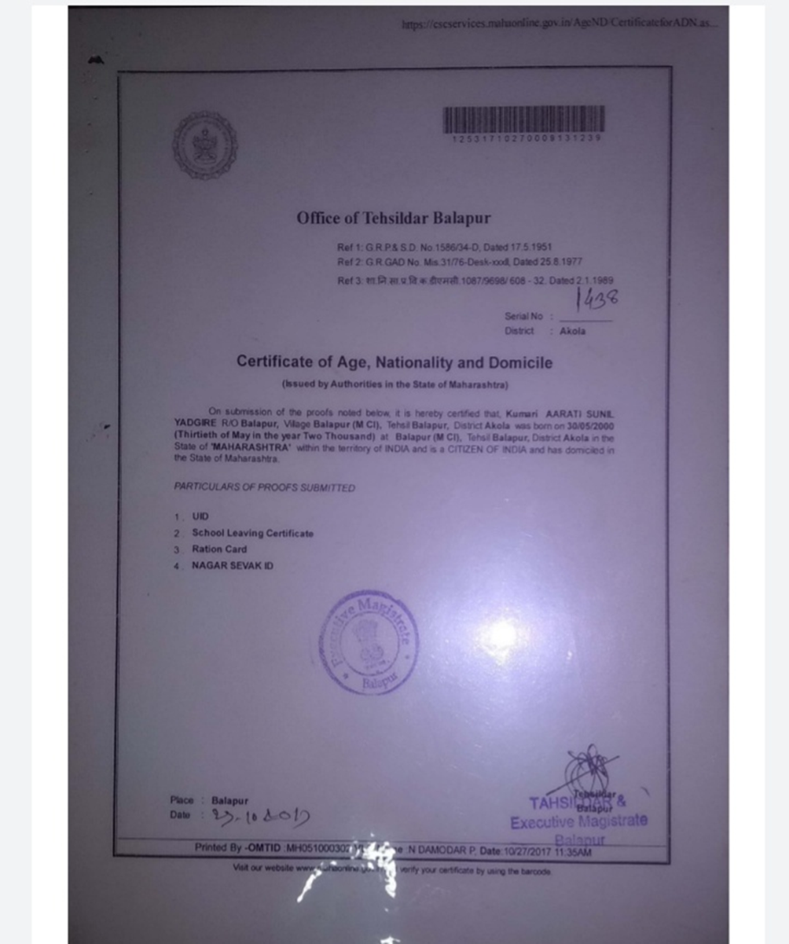
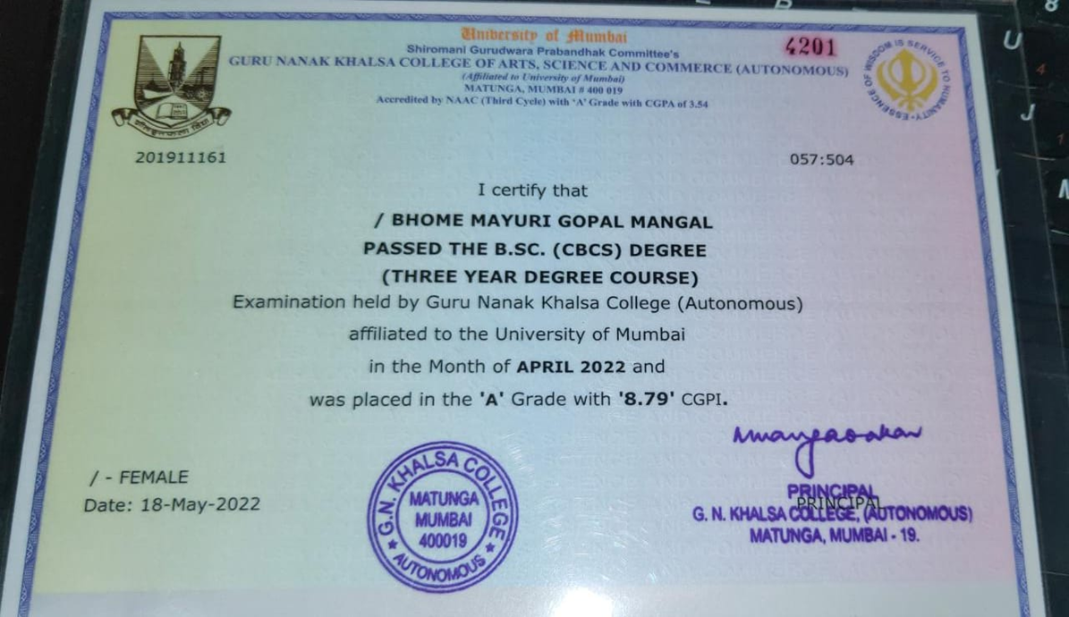
Original (2/2)

Slide 17
Accurate (1/3)
Accurate -
Does the recorded information describe the conduct the study without error?
Did the conduct of study conform with the protocol?
Who made the correction and when the correction was made?

Slide 18
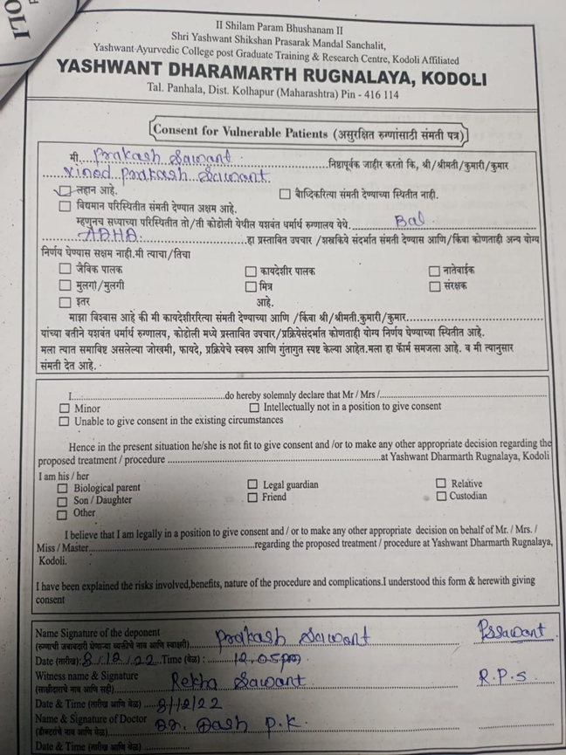
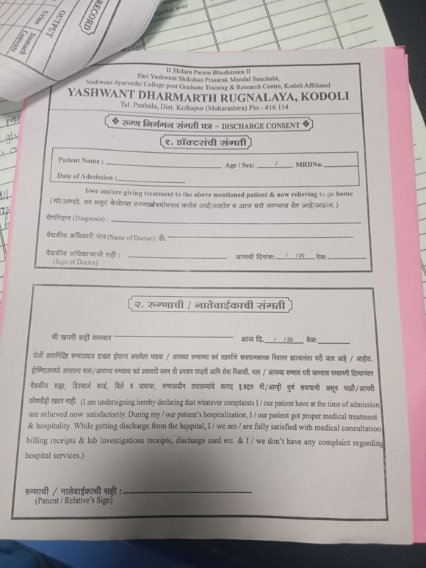
Accurate (2/3)

Slide 19
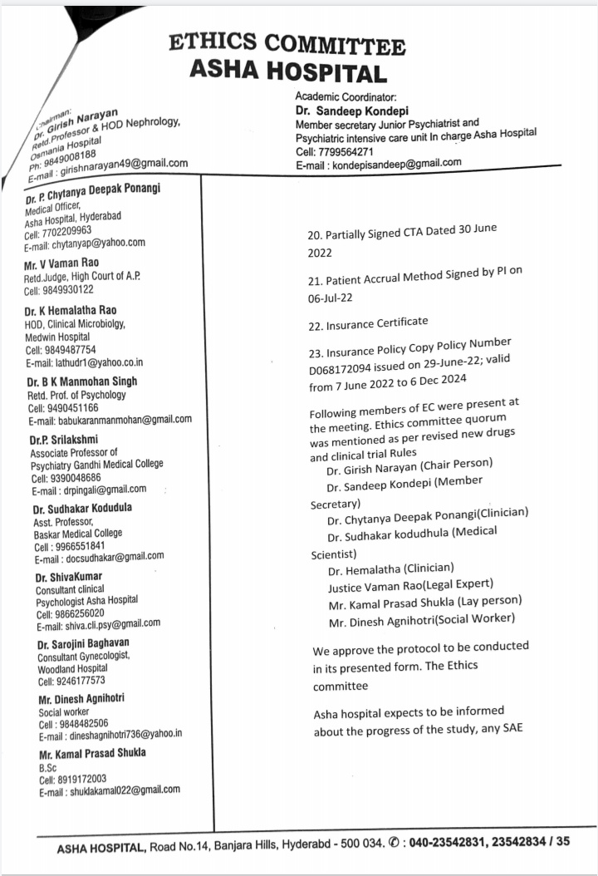
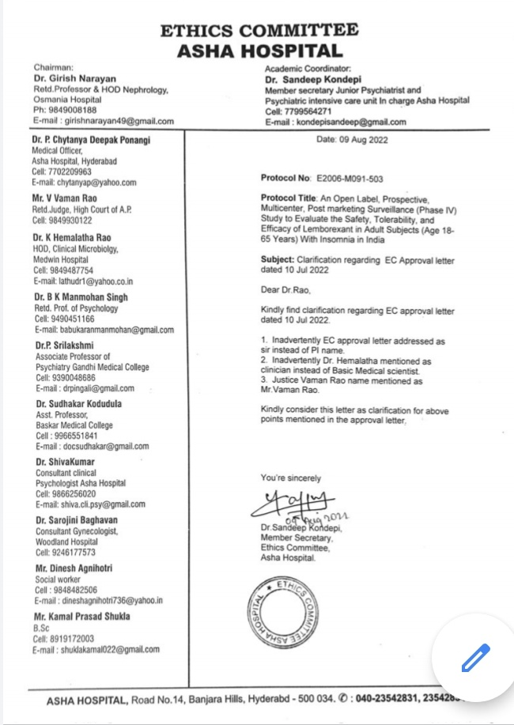
Accurate ( 3/3)

Slide 20
REFERENCE
WHO Guidelines on good data and record management practice
ICH-GCP E6(R2)

Slide 21
Thank you

